Slide 1
BASIC DATA ENGINEER KNOWLEDGE
DATA STORAGE : DATA WAREHOUSE, DATA LAKE, DATA MESH, OLTP VS OLAP
ETL VS ELT
ACID VS BASE
STRUCTURE VS UNSTRUCTURED DATA
ROW VS COLUMN ORIENTED
CACHE
FUNDAMENTAL OF DISTRIBUTED DATASTORE
SPARK
SHARDING VS PARTITIONING

Slide 2
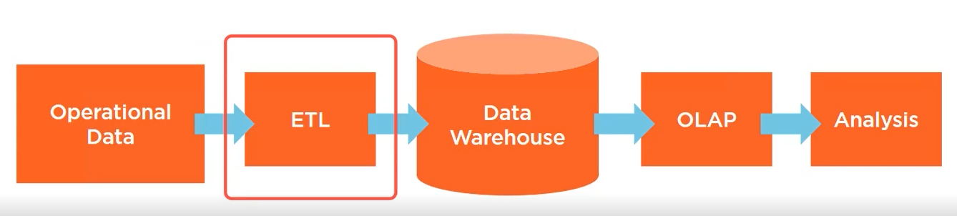
DATA WAREHOUSE
What is data warehouse ?- it is a storage for operational data that is consolidated and available for processing
Notes:
EXTRACT : extract it from the operational data
Transform : transform it to a format that fit the data warehouse
Load : Load to the data warehouse

Slide 3
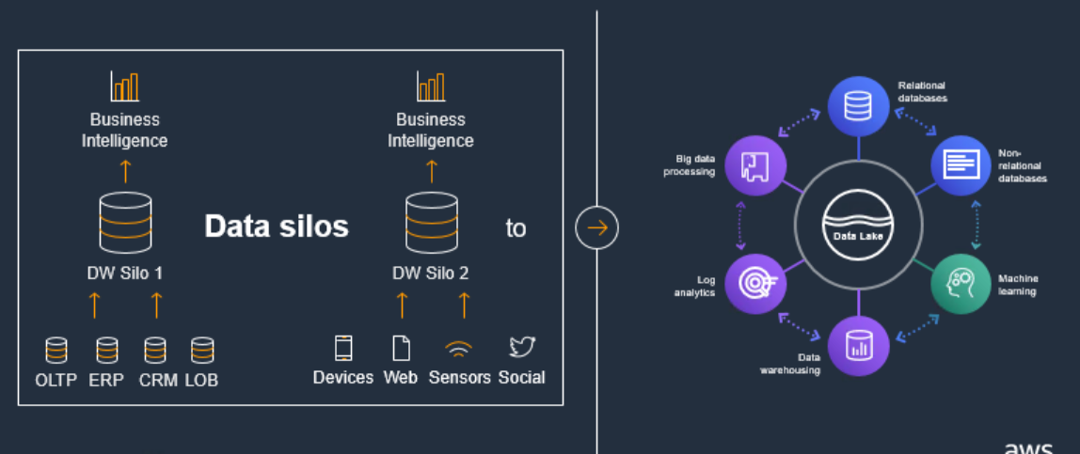
Moving from Traditional Data approach
Cloud Data Lake - Analytics Platform
Real use cases
Summary
Problems statement
Data lake Architecture
Q&A
Notes:
1/ So what’s happened over the last number of years, as customers have accumulated so much data, a lot of that data lives in different silos. And it’s really hard to do analytics when your data is stuck in different silos. The silos cause multiple problems – the data needed for a given workload may be split across multiple silos and inaccessible;the silos may require different management, security, and authorization approaches, increasing operational cost and risk.
* But customer need more than this, they Customer needs moe than just a place to handle extremely large data sets . they need to be able to run multiple analytics services against their data in order to ensure they have the right tool for the job. , move data between the data lake and the services – in all directions - from the inside out, from the outside in, and around the outside, unified governance across the data and services, to simplify securing, managing, and monitoring access to the data
. With a data lake, customers can store all their structured and unstructured data, using the open data format of their choice (like Orc and Parquet) and tag their data in a central, searchable catalog. while they need services that give them low cost without compromising performance or scale

Slide 4
Cloud Data Lake Motivation
Cloud Data Lake - Analytics Platform
Real use cases
Summary
Problems statement
Data lake Architecture
Q&A
Delivering Value
Modularity & flexibility
enable data teams to focus on innovating data instead of managing infrastructure
Easy tailor to orgnanization’s specific needs such as decoupling engine and storage
Automated
Speed matters
effortless , reproducible and fast deployments with low operation/ maintenance and easy administration
accelerating the delivery of enterprise data lakes comparing to on-prem architecture

Slide 5




Data Lake benefits
Performance & durability
Cost efficiency
Integration
No silos
consolidating multiple data types into a single, unified, infinitely scalable platform
A wide range of services around analytics and applications, and made these often “one-click” compatible.
Minimized capital expenses for hardware and software
From few small files to exabytes in size. Support high-volume ingestion of new data and high-volume consumption of stored data.
99.9999% annual durability.

Slide 6
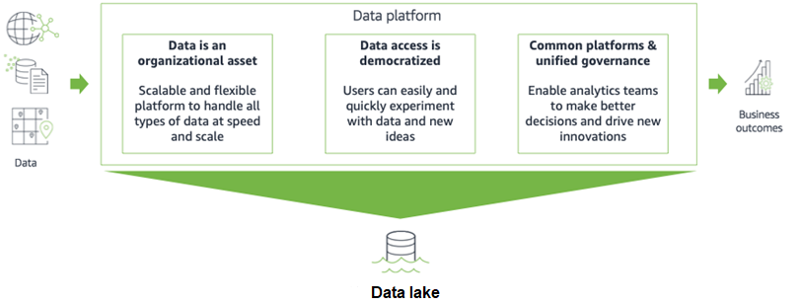
Why Data Lake
Cloud Data Lake - Analytics Platform
Real use cases
Summary
Problems statement
Data lake Architecture
Q&A
Centralized repository allows to store all of data, at any scale
Store data as-is
Run different types of analytics – from dashboards and visualizations to big data processing, real-time analytics and machine learning to guide better decisions
Notes:
Why Data lake
1/Data volumes are increasing at an unprecedented rate, exploding from terabytes to petabytes and sometimes exabytes of data. Traditional on-premises data analytics approaches can’t handle these data volumes because they don’t scale well enough and are too expensive.
2/We hear from companies all the time that they are looking to extract more value from their data but struggle to capture, store, and analyze all the data generated by today’s modern and digital businesses. Data is growing exponentially. It’s coming from new sources, is increasingly diverse, and needs to be securely accessed and analyzed by any number of applications and people.
Data Lake : Increase speed to which information is curated, added to the platform and access is provided to derive business value. It not only enable to provide a scalable centralized platform for all the data but also enable a unified data governmence for other data team to drive new innovation

Slide 7







Definition, Key features, Benefits
Cloud Data Lake - Analytics Platform
Real use cases
Summary
Problems statement
Data lake Architecture
Q&A
A Data Lake is a centralized repository that allows you to store all your structured and unstructured data at any scale
Single source of truth
Support Different Formats
Low-cost storage
Decouple storage & compute >> easy to scale
Fast ingestion & consumption
Schema on Read
Notes:
Single source of truth : all data is put in a centralized place
Support different formats : we can collect everything , from pictures, videos , json file format, row and columa format , litterally anything and put it in a centralize place. It really help your organization in gather and harness the power of your data and ultilize all data that available
Low cost storage : nowadays all clouds come with some type of object storage; for example in aws we have s3, azure we have blob storage and gcp we have gcs storage .all of these services are the cheapest to store on cloud, pay as you go and no requirement of upfront investment
Decoupling storage and compute : This is a very important concept in cloud . The component for storage is not linked to the component for compute so you can scale each component as required
Fast ingestion and consumption because we don't need to force it into a specific schema
Schema on read : data lake enable adhoc analysis by enable schema on read not on write, this way you can apply multiple analytics and processing framework to the same data

Slide 8
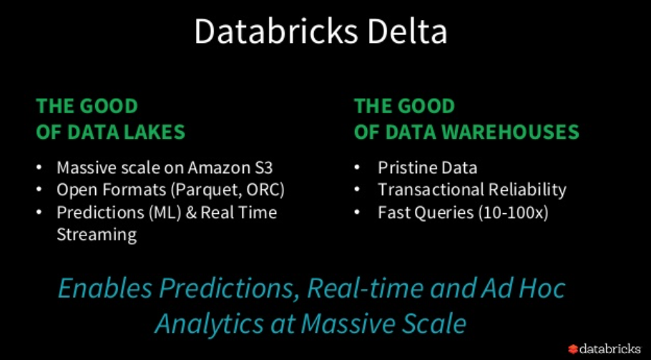

Slide 9
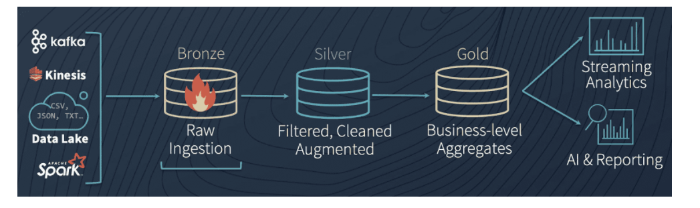
Delta Lake recommendation data lake layers
Notes:
https://databricks.com/blog/2019/08/14/productionizing-machine-learning-with-delta-lake.html Gold : Schema Enforcement
Delta Lake Silver table by enforcing our schema. Schema enforcement is an important feature for data scientists and engineers because it ensures that we are able to keep our tables immaculately clean and tidy.

Slide 10
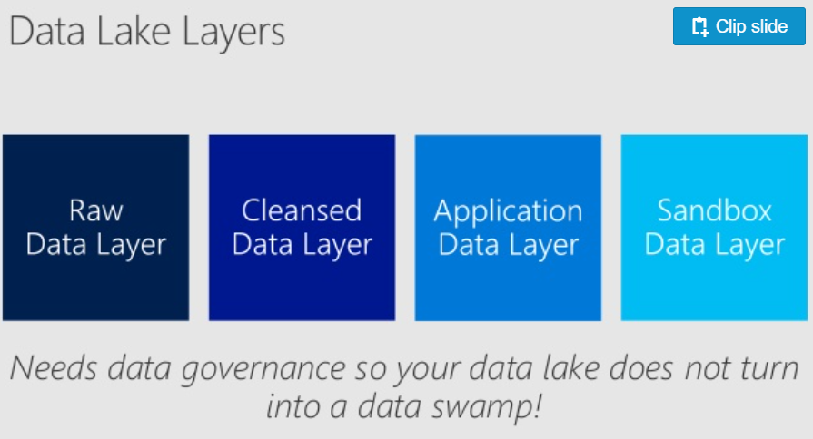
Sample Data Lake layers
Notes:
https://www.slideshare.net/jamserra/data-lake-overview

Slide 11
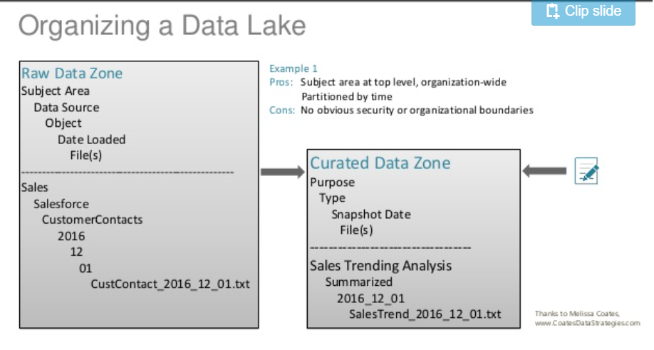

Slide 12
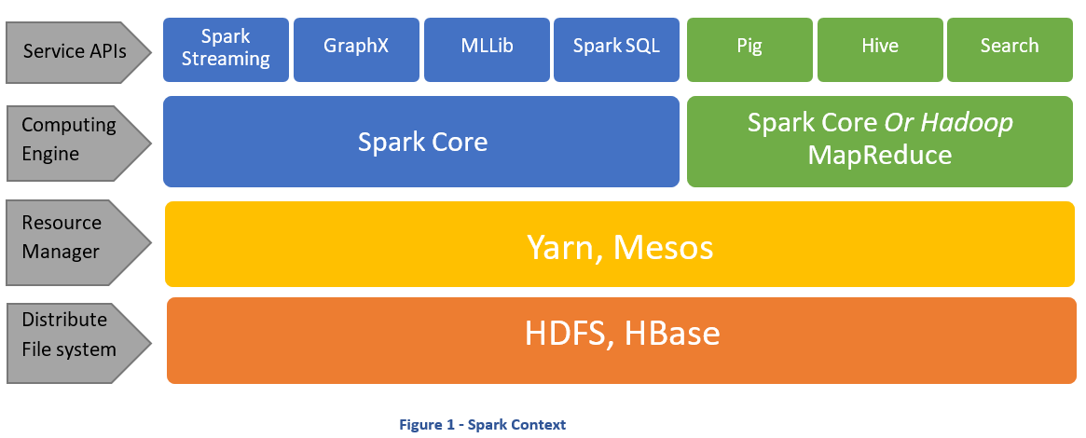
INTRO TO BIG DATA PROCESSING TECHNOLOGIES

Slide 13
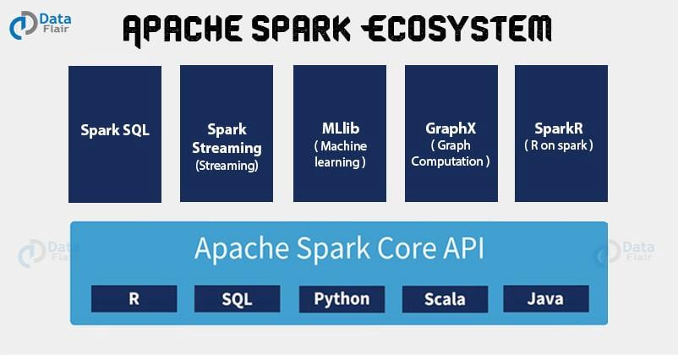
INTRO TO SPARK
Notes:
Koalas
Arrow

Slide 14
INTRO TO SPARK
WHAT IS SPARK ?
Fast, expressive cluster computing system , compatible with Apache Hadoop
Works with any Hadoop-supported storage system (HDFS, S3, Avro, …)
Improves efficiency through:
In-memory computing primitives
General computation graphs
Improves usability through:
Rich APIs in Java, Scala, Python
Interactive shell in Scala ( run on Java VM) and Python
WHY SPARK ?
When it comes to Big Data, it is much faster and easier than Hadoop or MapReduce to use due to its rich APIs
Large community support
Goes far beyond batch applications to support a variety of workloads
Including interactive queries , streaming , machine learning and graph processing
Notes:
Interactive queries : it use for real-time spark streaming Graph processing - a component of graphX
What I want you to remember from this slide Spark has a large community support, its polyglot - support multiple languages, work with hadoop supported storage system

Slide 15
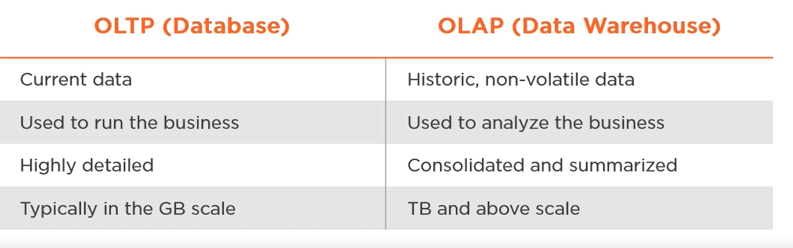
OLAP VS OLTP
Vocab: OLTP , OLAP , normalize : used to remove redundant data from the database, denormalize : used to combine multiple table data into one
Notes:
OLAP : slow query , denormalize data , planning and decision support, data is designed de-normalize , often design with complex queries , use for data mining
OLTP: snapshot of on going data, , controlling and running business task , the data source is from Operational Data , highly normalized , short simple queries

Slide 16
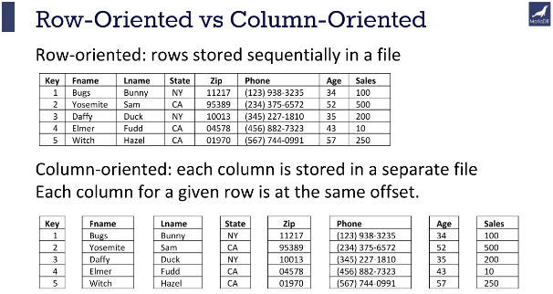
Row vs. Columnar oriented
Notes:
Row oriented works good for oltp workloads while columnar oriented works good for olap process

Slide 17
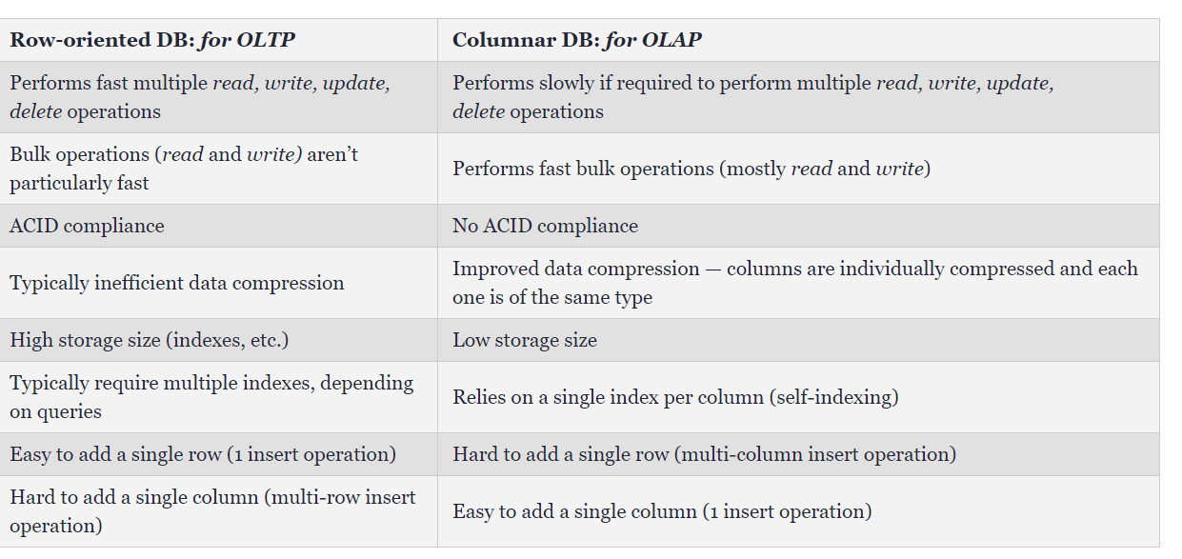
Row vs. Columnar oriented
Notes:
https://dzone.com/articles/the-data-processing-holy-grail-row-vs-columnar-dat

